Slide 1
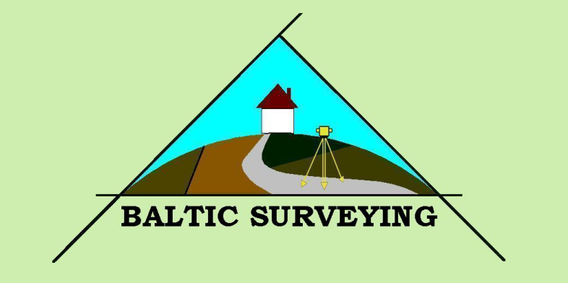


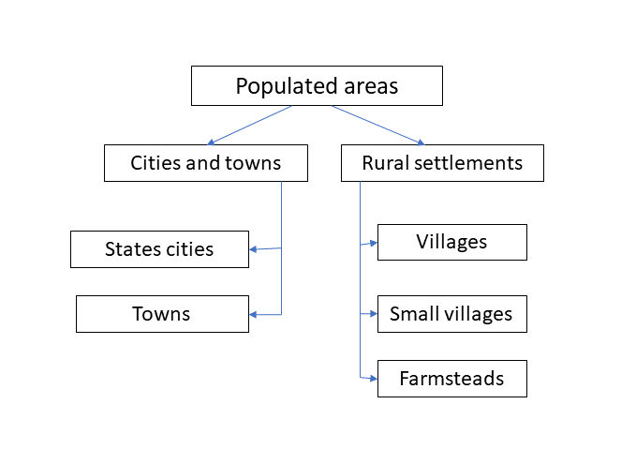
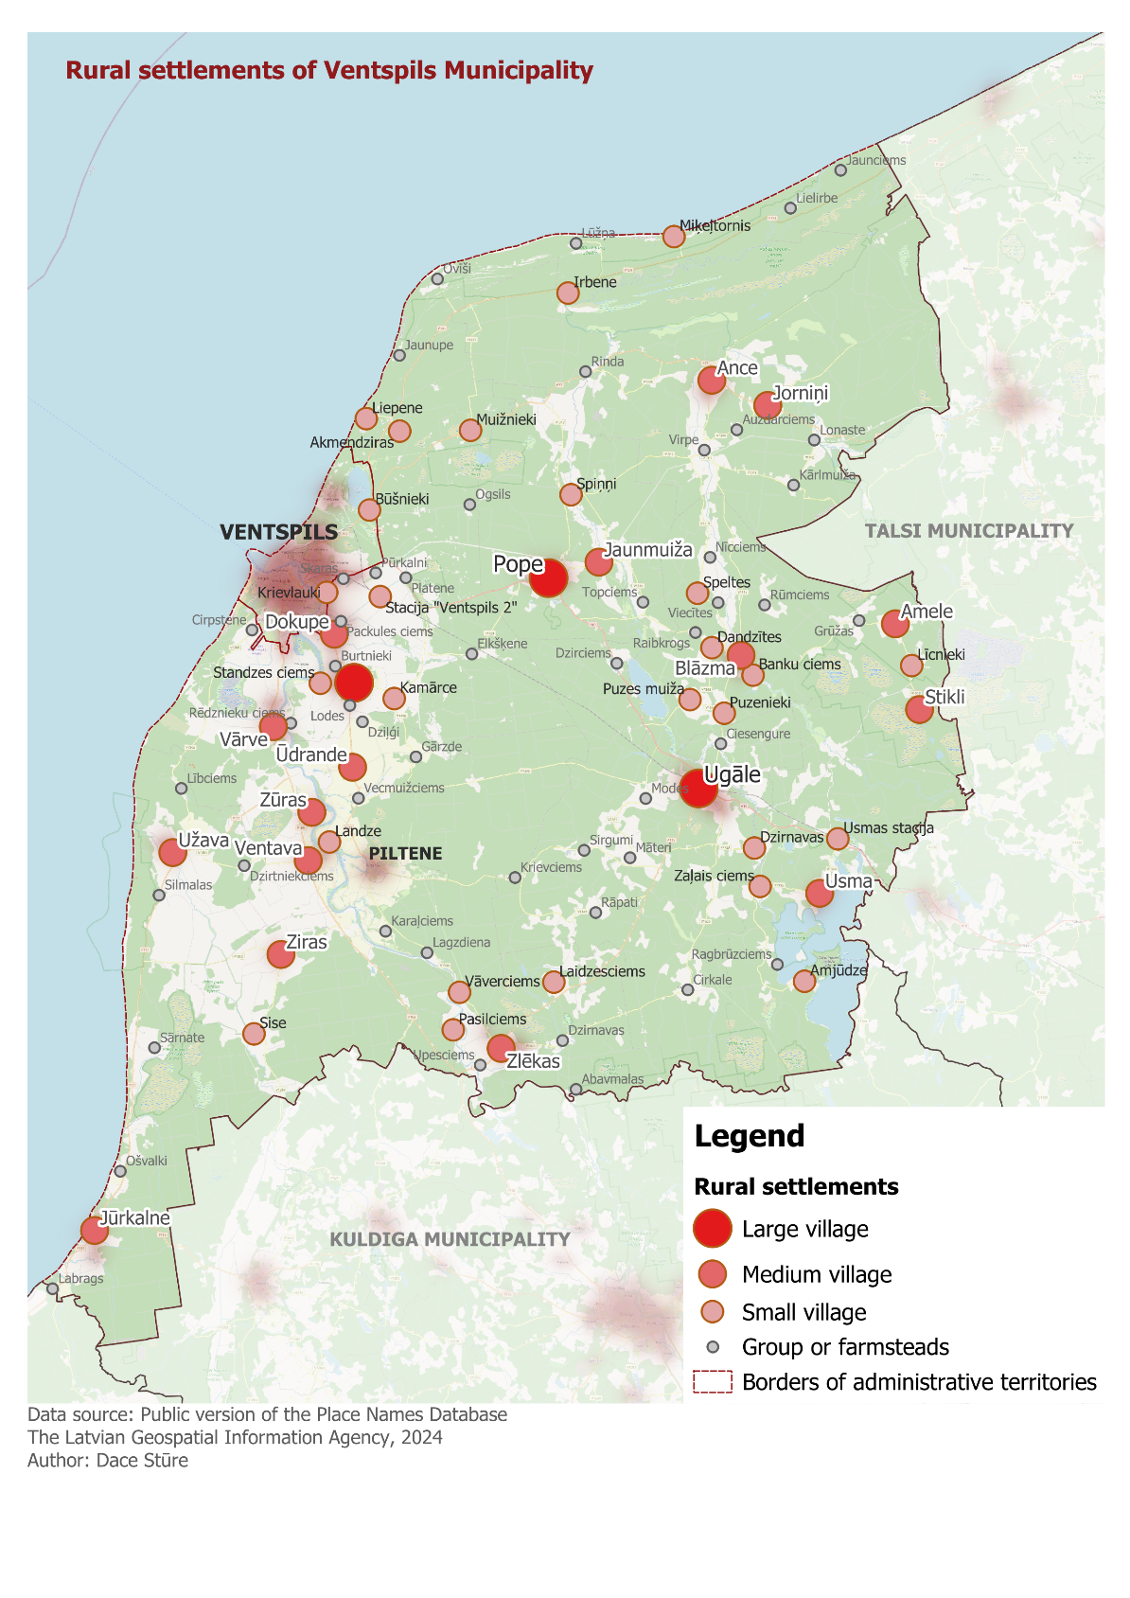
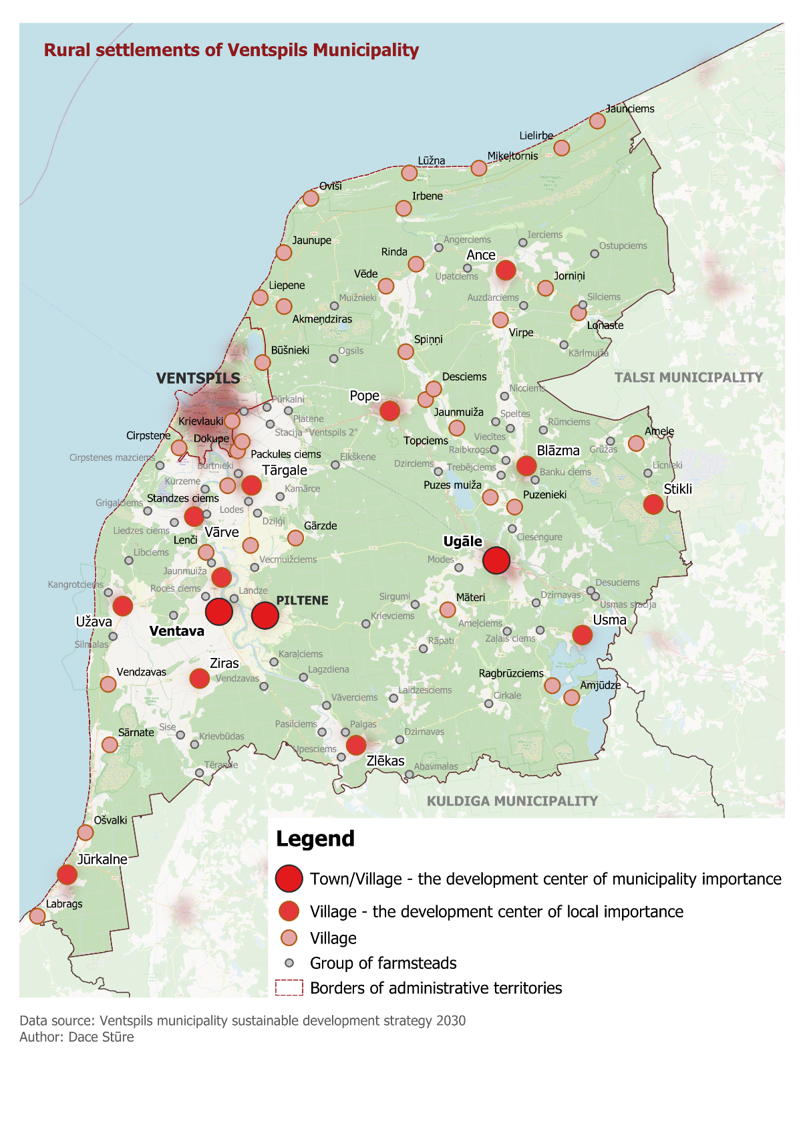
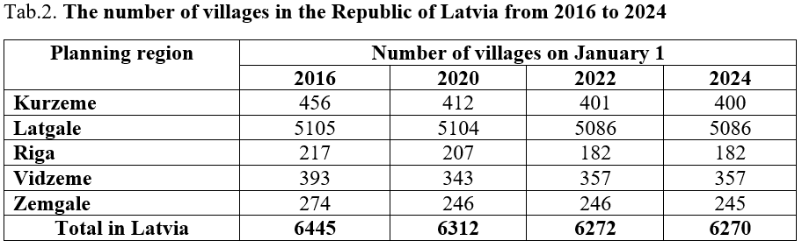
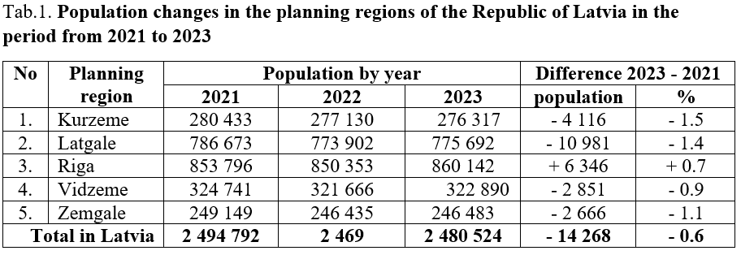
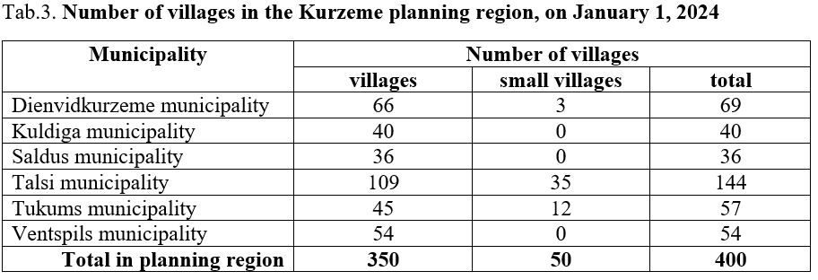

22nd International Scientific-Methodical Conference
BALTIC SURVEYING’24
Village planning in Latvia: criteria, processes and changes over time
Anda Jankava, Dace Stūre
Latvia University of Life Sciences and Technologies
The aim of the study is to evaluate the main aspects of rural settlement planning in the Republic of Latvia. The object of research is rural settlements, specifically - villages. The article analyzes the development of rural settlements in Latvia. Types of classification of settlements, their official classification and changes over time are evaluated. The study found that the population is decreasing in the entire territory of Latvia, with the exception municipalities around the state capital Riga (Tab.1). This process also affects the structure of rural settlements in the counties, the number of villages and their role as development centers decreases.
On June 10, 2020, the Saeima of the Republic of Latvia carried out another administrative reform by adopting the Law on Administrative Territories and Settlements. According to it, it was determined that there are the following inhabited places in Latvia: cities, villages, small villages, homesteads (Fig. 1).
As part of the study, an analysis of the location and development of rural settlements in the Ventspils municipality, which is located in the north-west of Latvia, in the Kurzeme planning region, was carried out. According to the data of the State Land Service, the number of villages in the Kurzeme planning region decreased by 56, from 456 villages in 2016 to 400 villages in 2024 (Tab.2). Among them, the number of villages in Ventspils municipality decreased by 38 during this period - from 92 villages to 54 villages (Tab.3).
According to the database of the Latvian Geospatial Information Agency, there are 100 rural settlements in the Ventspils municipality (Fig. 2), while according to the State Land Service data - in 2016 - 92 villages, on January 1, 2024 - 54 villages, 0 small villages, a total 54 villages.
In the sustainable development strategy of Ventspils municipality 2030, towns and villages are designated as development centers depending on their level of development, forming polycentric development structure. The population structure of the municipality consists of conditionally three-level development centers:
• development centers of municipality importance;
• development centers of local importance;
• villages (Fig. 3).
Fig. 1. Distribution of settlements in Latvia
Source: Law on Administrative Territories and Settlements, 2020
Fig. 2. The current distribution and location of rural settlements in Ventspils municipality, 2024
Source: Public version of the Place Names Database of Latvian Geospatial Information Agency
Fig. 3 The planned division and placement of rural settlements in Ventspils municipality
Source: Ventspils municipality syustainability development strategy, 2030
Source: compiled by the authors from the State Land Service data (2016-2024)
Source: compiled by the authors from the State Land Service data,2024
8th – 10 th of May, 2024, Jelgava, Latvia

