Slide 1
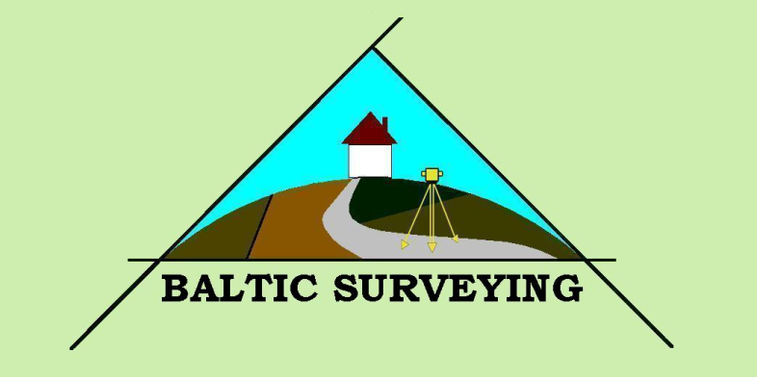
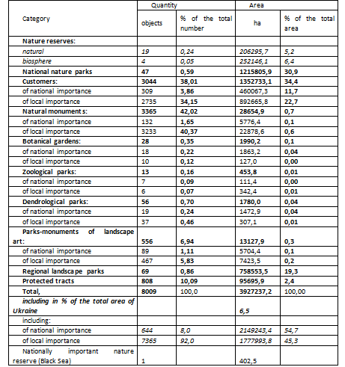
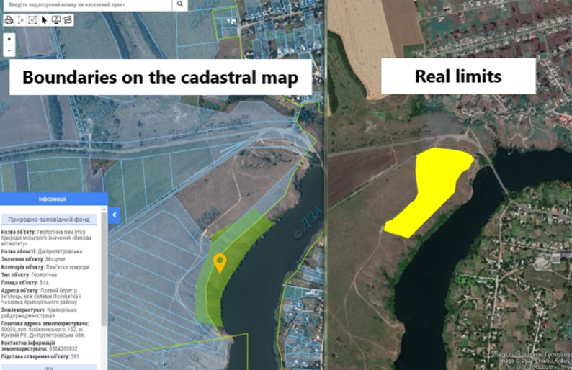
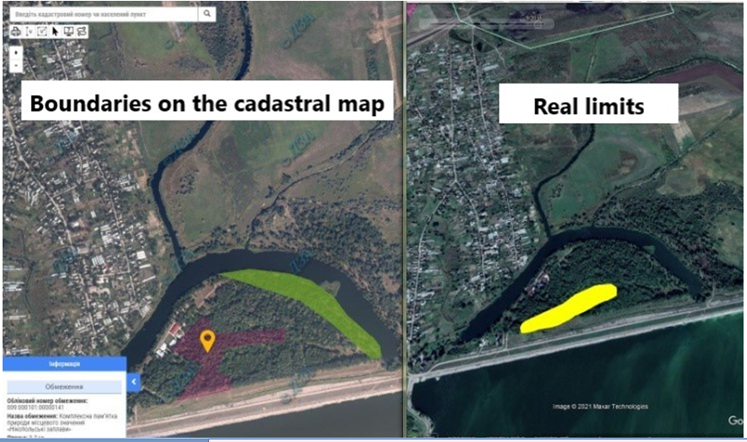

21stInternational Scientific-Methodical Conference
BALTIC SURVEYING’24
Priorities of the formation of environmental relations in Ukraine
Hetmanchyk Ivanna, Hunko Liudmyla, Pron Olha
National University of Life and Environmental Sciences of Ukraine
Introduction Environmental protection is an urgent issue in Ukraine and other countries, so it is important to identify the most effective strategies for preserving the environment. In the current conditions of social development, optimisation of conservation land use is of particular relevance, which should be achieved by improving its structure and environmental transformation of land. Improvement of the structure of environmental land use is carried out by changing its composition on economic grounds, which in most cases determines the possibilities and efficiency of land use (Lobunko, 2016). The analysis of the European Community legislation in the field of environmental protection is important for further improvement and enhancement of the environmental policy in Ukraine. At present, developed countries are in the process of transition to an ecological era, when social production, primarily in industry, should function and develop not only on the basis of economic but also environmental laws and regularities, taking into account objectively existing environmental limits and restrictions. Methodology of research and materials The methodology for studying the processes of improving nature conservation land use includes the study of the regularity of formation of organisational and economic, ecological and economic, engineering and technical, and legal changes in the composition of land and functional use of land which affect the ratio of territorial conditions for land use, in particular, an increase in the area of cultural landscapes and territories of the nature reserve fund, and a change in the land use regime and intensity of land use. To this end, it is substantiated that the process of organising spatial conditions for the conservation of biological diversity in Ukraine, in the formation of land use of the territories of the nature reserve fund, is a set of actions leading to the formation and improvement of the relationships between the parts of the whole. The methodological basis for improving nature conservation land use is the methods of experimental research related to the structure of land use of territories and objects of the nature reserve fund or structural elements of the ecological network. Discussions and results The formation of conservation land use is a complex process of determining the multidimensionality of land relations and the multifunctionality of the use and protection of land and other natural resources, where it is characterised by the spatial combination of individual land plots with different functions, the combination of different functions in relation to one land plot, but separated in time, and the integration of all functions inherent in the land plot in the time period. In particular, when agricultural land use is included in the structural elements of the Ukrainian ecological network as the main one, it is necessary to provide (design) other types of land use, such as recreational or environmental protection, depending on its suitability, the value of other natural resources within it or the state Movchan Ya. (2001)of land degradation. As for the European legislation, according to the Ministerial Declaration adopted at the Third Ministerial Conference "Environment for Europe", Sofia (Bulgaria), 25 October 1995, Europe has a strategic task "to ensure full conservation of biological and landscape diversity within 20 years, including, inter alia, protection of the last unconverted rivers, wetlands and seashores, as well as the last remaining virgin forests in Europe. The resolution on biological and landscape diversity adopted at the Fourth Ministerial Conference "Environment for Europe" recognises the progress made in the establishment of the Pan-European Ecological Network as a means to promote nature conservation within and outside protected areas, and underlines the role that international conventions and programmes (in particular the Bern Convention's Emerald Network and the European Community's Natura 2000 network), as well as international exchange of experience, play in the establishment of the network. It also reaffirmed their commitment to the establishment of a Pan-European Ecological Network, took note of the map and information contained in the report on protected areas established as a result of the application of international environmental instruments at the European level, and approved the progress in developing the Guidelines for the establishment of a Pan-European Ecological Network as an appropriate basis for the establishment of this network. The main task of the pan-European ecological network is defined as "ensuring a favourable conservation status of ecosystems, habitats, species and landscapes of European importance. To do this, it is necessary to ensure the protection of typical ecosystems and natural habitats, as well as landscapes of European importance within their normal distribution, to ensure the sustainable use of semi-natural habitats and cultural landscapes of European importance, to maintain the viability of populations of species of European importance within their typical range, and to support the natural processes on which these ecosystems, habitats, species and landscapes depend”. The European community is raising an important issue, but at the same time, it understands that in different European countries, which are at different stages of socio-economic development, the creation of an ecological network requires different approaches and is not linear. Today, there is a need to restore the authentic natural environment, but there is no sufficient financial and economic support for these intentions. It is no coincidence that the European community, which is keenly interested in including these territories in the structure of the European ecological network, provides quite significant funds and moral support for the implementation of the ideas of forming the European Ecological Network, including in Ukraine. Otherwise, even if the ideology of creating an eco-network in Europe is ideally implemented, this work almost loses its essence. Because intermediate spaces are created. Which break the integrity of the European eco-network. It is worth noting that Ukraine is one of the leaders in the development of the European ecological network at the legislative level. It has already made considerable achievements of its own, which have become a significant basis for the existence of the European Ecological Network as a whole. The above makes it necessary to set out in the current legal mechanism the levers and norms for the formation of the ecological network and environmental land use regarding the procedure for developing, coordinating and approving relevant local-level documentation, justifying restrictions and burdens on environmental use in its composition and registering them in the State Land Cadastre. The local level of environmental land use should be recognised as the basic level, since only territorial communities can not only preserve the natural environment, but also develop it with minimal costs. Thus, the basic acts of environmental legislation should be supplemented with mechanisms and instruments to ensure adequate management of land and natural resources within the territories of local councils. Improved cadastral registration of the territories of the structural elements of the ecological network as territorial nature protection zones should play an important role in this process. Ultimately, the design of the structural elements of the ecological network is the formation of territorial zones as territorial environmental restrictions (encumbrances) on the use of land and other natural resources. the purpose of territorial land management in this case is to determine the boundaries of restrictions, their size and list, taking into account the requirements for the rational use and protection of land, conservation of natural diversity of landscapes, environmental protection, and maintenance of ecological balance (Table 1). Table 1. Characteristics of land use of territories and objects of the nature reserve fund of Ukraine by categories and functional purpose . Conclusions and proposals. In Ukraine, the issue of forming environmental relations requires special attention of the government in the context of integrating environmental issues, involving all stakeholders in the process of developing and implementing environmental policy, and creating effective environmental institutions. In order to ensure the implementation of the state policy on the organisation, protection and efficient use of the nature reserve fund of Ukraine, and to fulfil Ukraine's European integration commitments to the European Union, it is necessary to amend the legislation of Ukraine, since the current system of state management of the nature reserve fund and other areas of environmental protection is characterised by weak institutional mechanisms, low human, logistical and financial capacity.
Land management projects for the formation of structural elements of the ecological network as territorial restrictions (encumbrances) on the use of land within the territories of councils determine the location and size of land plots. The Ministry of Ecology is working to create an open database of the state cadastre of territories and objects of the nature reserve fund. This should be a prototype of the open database of the state cadastre of territories and objects of the nature reserve fund of Ukraine. Such a database would include information layers on nature reserve fund boundaries, functional zoning, land users and owners, biodiversity data, recreational resources, etc. It should be adapted to similar European ones. This will allow for the exchange of information on biodiversity in the European space, and for the data to be reflected in international open information systems of protected areas such as Natura 2000. Procedures for data exchange between other state databases and stakeholders will also be established. This will improve the way data is entered, stored, accessed, managed and disseminated. It is worth noting that in June 2021, the "Nature Reserve Fund" layer was added to the public cadastral map (https://cutt.ly/Un8LCW5). It includes the boundaries of more than 7,000 protected areas (https://bit.ly/3d0xPNR). However, the accuracy of the published boundaries varies widely. Our cursory analysis has shown that in some oblasts, the boundaries of the nature reserve fund are shown very well, while in other oblasts they are completely wrong. Here are examples of obviously erroneous boundaries (Fig. 1).
Fig. 1. Errors within the boundaries of a nature reserve fund interaction. This means that, for example, these contours can be used for the initial detection of violations (land plots granted into private ownership or ploughed within the NRF), but to prepare the relevant complaints, you will have to request copies of the relevant maps from the Department of Ecology of your regional state administration. Thus, this layer is of an informational nature, the boundaries of the nature reserve fund should be clarified, the "Nature Reserve Fund" layer of the cadastral map should be edited and the information should be constantly updated. According to the European Commission, Ukraine is at an early stage of European integration in the field of environmental protection and climate change adaptation. In fact, Ukraine received one out of five points from the European Commission, which emphasised the need to implement the requirements of the EU Habitats Directive and create a proper system of management of protected areas
8- 10 May 2024, Jelgava, Latvia

